Slide 1
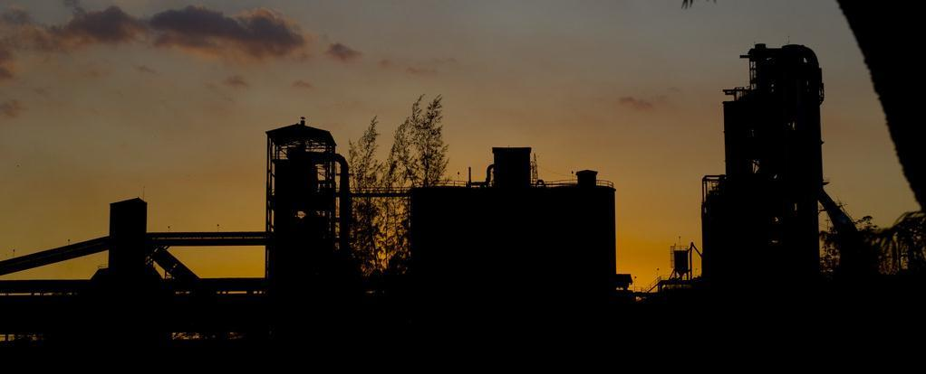
Raw Meal Homogenisation
Technical Development Program for PPE, 2015-2016

Slide 2
Contents
Auditing of Blending Silos
Targets
Inspection
Sampling campaign
Common problems & solutions
Kiln dust handling
2

Slide 3
Benefits of good homogeneity / uniformity
Reduced consumption of correctives
Lower kiln heat consumption
Lower refractory consumption
Possibility to increase TSR
Improved clinker reactivity
Improved clinker grindability
Lower electrical energy consumption
Lower cost!
Notes:
SG: reduction STDEV from 2.5 to 1 , resulted in a reduction of the LS fet point by 2 points = 0.12 EUR/tck less in thermal cost (1’000 ktck/a)
TN: reduction of STDEV ? Led to a reduction of the heat consumption by 170 kJ/kgck = 225 kEUR/a (500 ktck/a)
SH: reduction STDEV from 3.01 to 2.1 in kiln feed = reduction heat consumption from 3.57 GJ/tck to 3.42 GJ/tck and improved clinker reactivity from 33 MPa to 35 MPa.
General FLS formula: -1% in lSF STDEV = - 100 kJ/kgck

Slide 4
Raw Meal Homogenisation
Targets
4

Slide 5
Auditing of Blending Silos
Check if targets are reached
If they are not reached, find the root cause (quarrying, preblending, homogenising, …). If short term fluctuations are an issue
Test blending efficiency of homogenising silo
If blending efficiency is lower than required (and lower than achievable with your silo system)
Check homogenising silo operation parameters
5

Slide 6
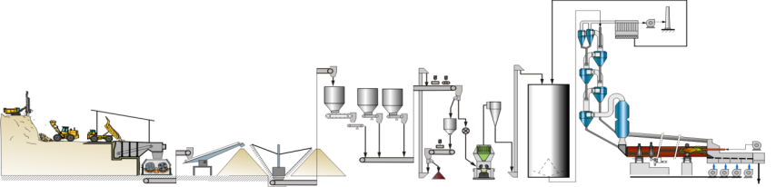
Targets for Homogenising Silos
Raw meal: s_{LS} < 3.6 (short term)
Kiln feed: s_{LS} < 1.2 (short term)
Blending factor (BF) guide values:
> 5:1 for batch type mixing silos
< 5:1 for continuous blending silos (typically 3:1)
→ BF depending on raw meal uniformity!
6

Slide 7
Product Uniformity Targets
Short term
Long term
Hourly samples
Daily values over
over 24 h
one month
LS
σ
< 1.2
< 1.0
Kiln feed
SR
σ
< 0.04
< 0.03
(or clinker)
AR
σ
< 0.04
< 0.03
ex mill
Raw meal
LS
σ
< 3.6
< 1.0
7

Slide 8
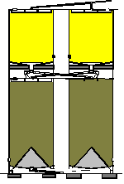
Refreshing the Basics
Three types of homogenising silos
Batch type mixing silo
Continuous blending silo
Multi-pack silo
Homogenising silo
Storage silo
Most frequent old plants
Most frequent newer plants
Marginal spread
8

Slide 9
Raw Meal Homogenisation
Inspection
9

Slide 10
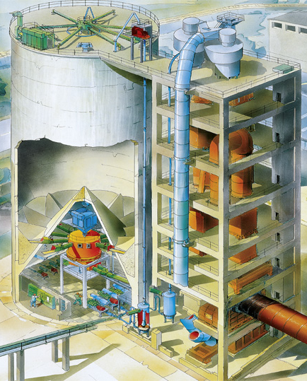
Checklist – System design - built
Drawings
Silo dimensions and volumes
Aeration system
Number of aeration sectors and their arrangement
Air pad dimensions and arrangement
Blower specifications (air flow rates & pressures)
Air distribution and type of valves
10

Slide 11
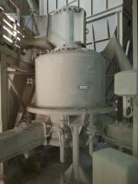
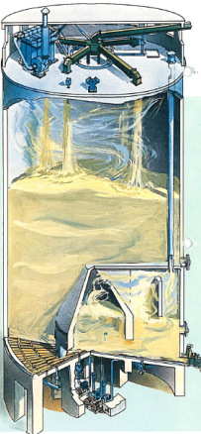
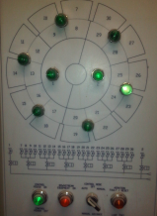
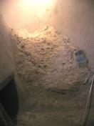
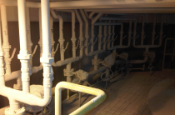
Checklist – Equipment state – operation
Condition (tightness) of silo roof and walls
Raw meal coating on silo walls and bottom
Lump formation issues
Silo emptying degree
Raw mill distribution at silo feed (material layering)
Raw mill / kiln feed production rate
History of filling degree (operating range)
Sector aeration sequence and times
Kiln feed mode
Dust handling mode during direct kiln operation
11

Slide 12
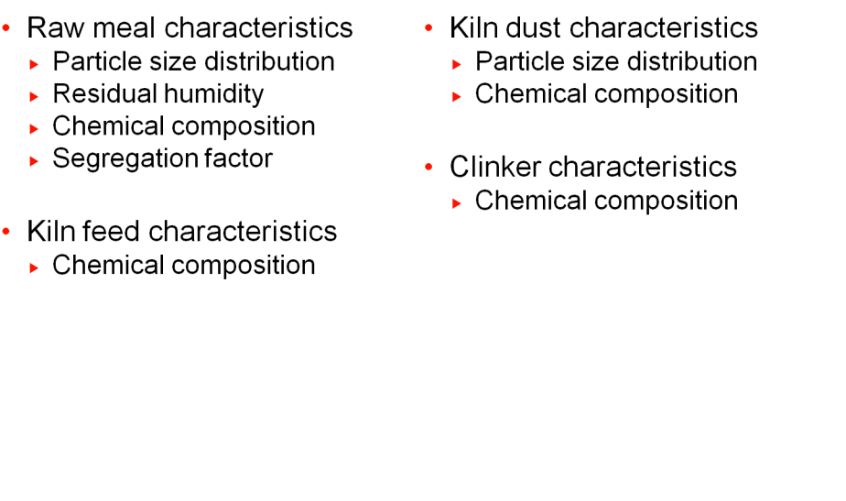
Checklist - Material Quality
12

Slide 13
Raw Meal Homogenisation
Sampling Campaign
13

Slide 14
Sampling
Define locations / set sampling ports
Spot samples, 1kg, every 30 mint, during 24 h at silo inlet & outlet (for batch silos: sample three batches).
Minimum 30 samples
Double sampling (two consecutive spot samples) in case of guarantee discussions
Parameters to be measured:
Moduli (LSF, AR, SR)
Moisture
Fineness
14

Slide 15
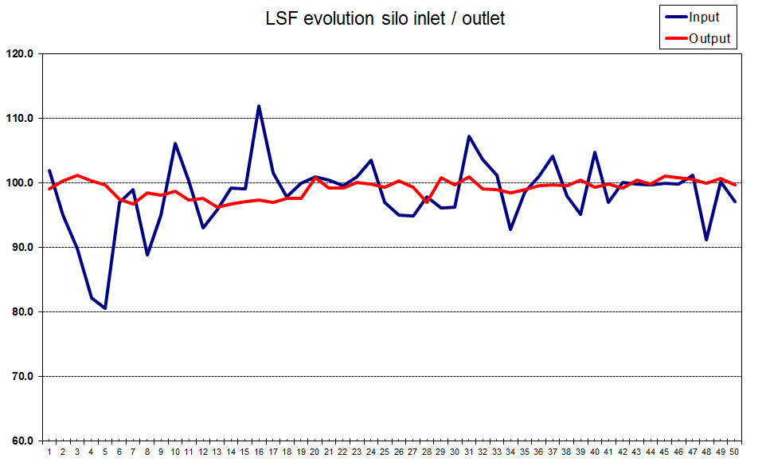
Evaluation
Remove outlayers = Aver I ± ~3 x STDEV
Aver. Input = 98.2
STDEV in = 5.5
Aver. Input = 99.2
STDEV out = 1.3
Blending factor =
STDEV in = 5.5
STDEV out = 1.3

Slide 16
Raw Meal Homogenisation
Common Problems & Solutions
16

Slide 17
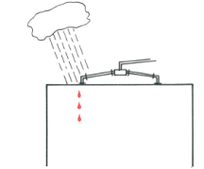
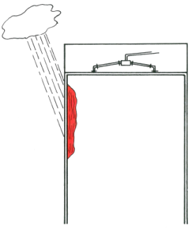
Lump Formation & Build-ups
Water ingress
Seal roof and walls
Silo rains (condensation on silo roof)
Investigate on insulation for silo roof
Operate silo dedusting 24h
Wall condensation through wind chill
Investigate on installation for wind shields and/or insulation
High residual moisture in raw meal
Investigate on drying process before and in the raw mill
17

Slide 18
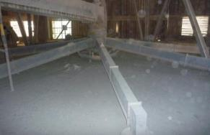
Segregation in Silo
Segregation due to non uniform raw meal distribution
No distribution spider on unfavourable design
Inconsistent feed rate
Unlevelled distribution box
Eccentric feed point
18

Slide 19
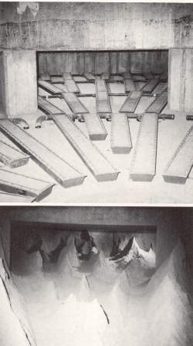
Aeration Blockages
Silo cleaning and air pad maintenance must be performed on a regular basis
When the silo is empty, only a small amount of material should remain between the air pads on the silo floor
Possible reasons for fabric blockages include
Moist or contaminated aeration air (e.g. with oil)
Broken fabric
19

Slide 20
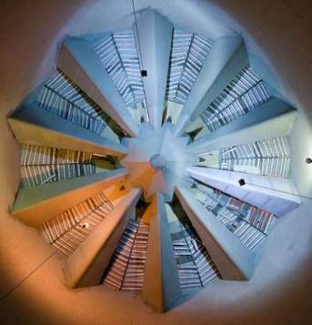
Material Coating
Consider coating concrete structure and cone with special paint
Abrade all surfaces using 40 grit sanding poles
Vacuum clean to remove all dirt / dust
Apply two coats of special paint at a normal 100μm dry film thickness
E.g. “Dulux Durebild HSE” epoxy
20

Slide 21
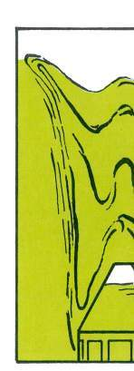

Excessive Aeration Times
Too short aeration times (e.g. < 5min.)
No proper material funnel can form
Lower blending efficiency
Material starvation close to the wall
Too long aeration times (e.g > 10min.)
Shortcuts for fresh material → Low retention time
Lower blending efficiency
Short vs. long aeration
21

Slide 22
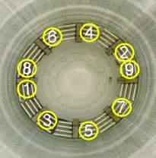
Inadequate Aeration Sequence
Silo operation at low filling degrees
Low number of material layers combined
Operate continuous blending silos above 70% filling degree
Activate single sectors at a time rather than two opposite sectors
Do not aerate sectors sequentially, jump instead
Prevents intersection of material funnels at surface
Can have impact on structural forces
22

Slide 23
Amount of Aeration Air & Distribution
Too little aeration air can lead to material starvation along the wall
Too much aeration can lead to non uniform extraction
Manual distribution valves on silo wall should be completely open to activate this material, valves close to extraction are more closed
Outer ring sectors need to be activated together with central chamber sectors
10%
100%
100%
100%
23

Slide 24
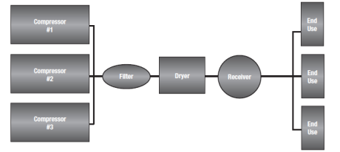
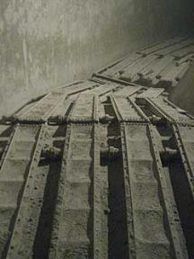
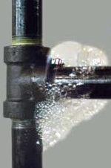
Insufficient Aeration Air Quality
Improve water / oil separation from air
Secure adequate permeability of air pads
Replace fabrics when plugged
When replacing air pad system, upgrade from ceramic tiles to fabric type
Check for leaks in the distribution system (soap test)
Secure proper functioning of air distribution valves (solenoid instead mechanical valve system)
24

Slide 25
Raw Meal Homogenisation
Kiln Dust Management
25

Slide 26
Kiln Dust Management
There are several ways to handle kiln dust in
Compound operation: Raw mill is operating
Direct operation: Raw mill is stopped
The choice depends on
Installation / arrangement
Segregation factor (SF)
26

Slide 27
Segregation Factor
Segregation factor
Describes tendency to cause segregation problems
Is an indication for high deviation of kiln dust chemistry from raw meal chemistry
or
Critical
Critical
Sf < 0.8
0.8 < Sf < 1.2
Sf > 1.2
27

Slide 28
Option 1
Compound operation: Raw meal and kiln dust to blending silo
Direct operation: Kiln dust to kiln feed bin
SF not critical
(0.8 < SF < 1.2)
Standard arrangement
Step variations between compound and direct operation
May become excessive with critical SF
28
Notes:
A 4800 tpd kiln = 200 tph clinker = 320 t/h meal feed & 16 t/h – 32 t/h dust depending on top cyclone efficiency recovery
For
This allow a simple simulation based on

Slide 29
Option 2
Kiln dust always bypassing blending silo
Compound operation
Direct operation
SF not critical
(0.8 < SF < 1.2)
Separate filter dust transport
Similar chemical composition of kiln dust during compound and direct operation
For critical SF to be evaluated
29

Slide 30
Option 3
Compound operation: Raw meal and kiln dust to blending silo
Direct operation: Kiln dust to separate dust bin
SF critical
(0.8 > SF > 1.2)
Standard for critical SF
Expensive
Optional bypass for heavy metals and chlorine
30

Slide 31
Raw Meal Homogenisation
Annexes
31

Slide 32
Evaluation (1/3)
Outlier test (according to GRUBB’s)
Get rid of the results which are outside expectation (confidence interval) due to sampling and analysis errors
G: Critical value (function of number of samples)
S: Standard deviation
X: Value
X: Average of all values
n: Number of samples
→ Values higher than about 3 times the standard deviation are considered outliers
n | G
20 | 2.884
25 | 3.009
30 | 3.103
40 | 3.240
60 | 3.411
32

Slide 33
Evaluation (2/3)
The blending factor
Defined as the ratio of the incoming and outgoing product variability expressed as standard deviations (corrected by the sampling error)
33

Slide 34
Evaluation (3/3)
Sampling and analysis errors
Double sampling (two individual samples taken immediately after each other) allow for a calculation of the sampling / analytical error
di: Difference between the double sample (x_{1a} – x_{1b})
s_{err}: Standard deviation of sampling error
34

Slide 35
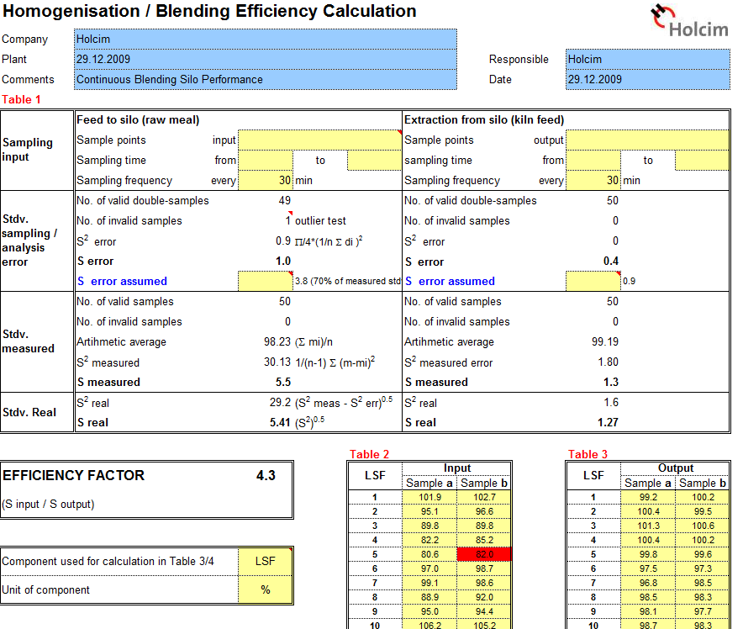
Spreadsheet for silo efficiency evaluation
Spreadsheet available for blending efficiency evaluation
35

